Slide 1
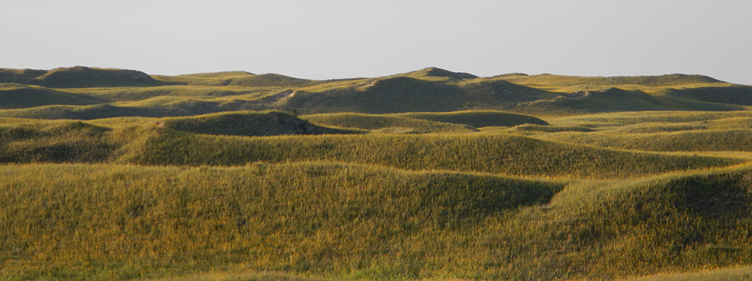
Global Climate Change Science
Glacial deposits and sand dunes in Nebraska –> locally climate changes significantly. Global correlation of events indicates global climate changes significantly – e.g. Ice Ages. Climate change history is in the geologic record.
Is the earth’s climate warming recently?
What drives global climate change in general?
What is causing change in the last 200 years?
How will surface system behavior likely change?

Slide 2
Direct measures of change in surface temperatures.
4 main databases to work with:
- Global averaging of terrestrial surface Temperatures.
- Global averaging of seawater Temperatures.
- Satellite data of upper atmospheric Temperatures.
- Temperatures in the ground (shallow geothermal gradients).
Summary of results of a large amount of research:
- Strong consensus that earth has warmed .3 to .5 degrees Celsius on average in last century.
- The effects are much more marked in polar regions than equatorial.
- The effects differ regionally - one place may cool, while the globe on average warms!
- The effects on biologic systems are already being seen.

Slide 3
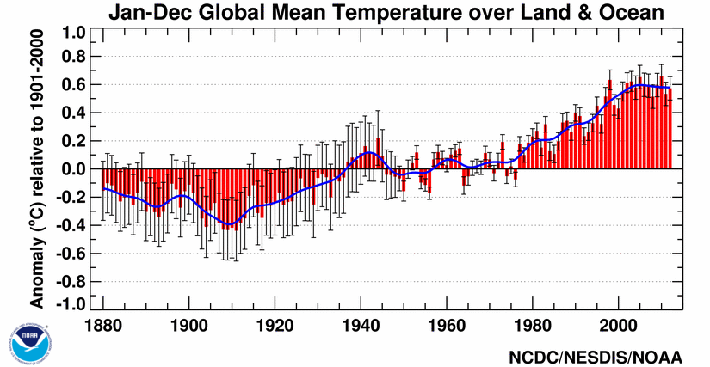
https://www.ncdc.noaa.gov/sotc/global/2010/13
Note earlier plateau.
Note recent plateau.

Slide 4
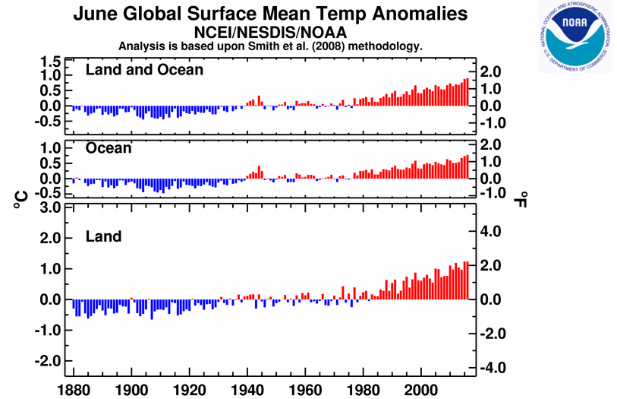
Data for June 2016. Information source: NOAA - https://www.ncdc.noaa.gov/sotc/global/201606

Slide 5
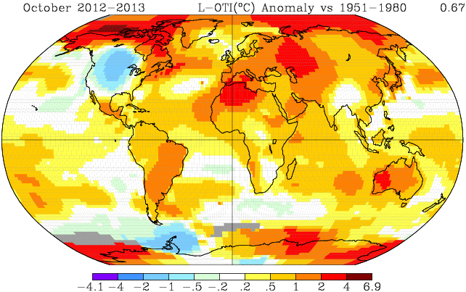
Temperature anomaly map using the average from 1951-1980 as a baseline, and for the month of October in 2012. You can make your own maps for different baselines and periods using the website - http://data.giss.nasa.gov/gistemp/maps/ . Note the hotter anomalies in the Arctic, which is a persistent result for different baselines and time periods.

Slide 6
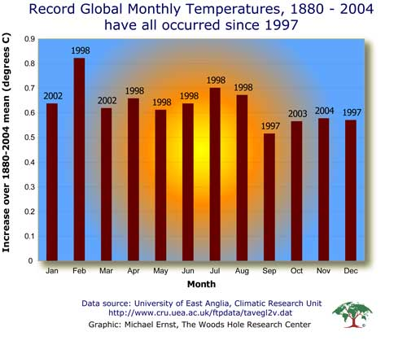
Another way to look at it. What are the chances? Source:http://www.whrc.org/resources/online_publications/warming_earth/scientific_evidence.htm
YouTube animation of spatial distribution of T changes since 1880 - http://www.youtube.com/watch?v=X8XqHwSrakA

Slide 7
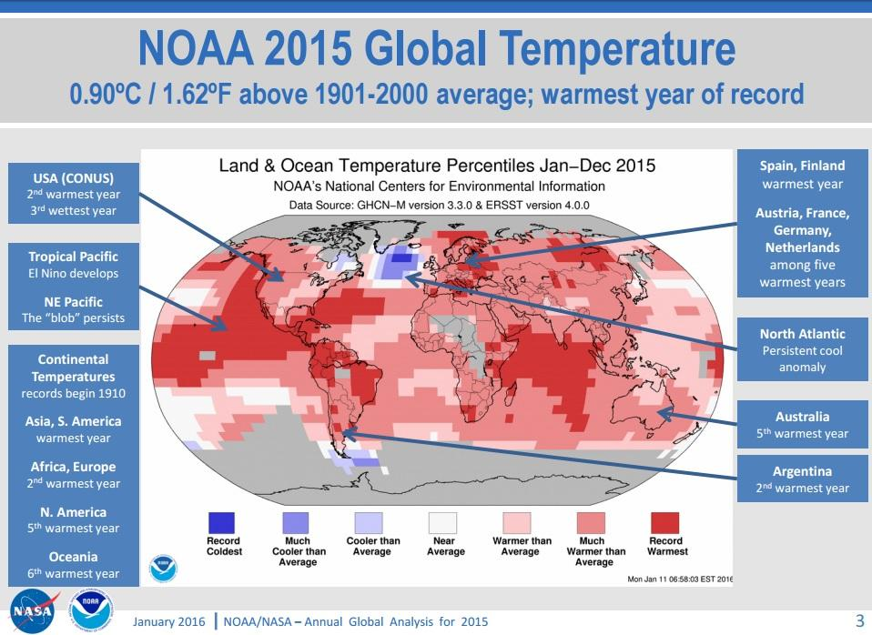

Slide 8
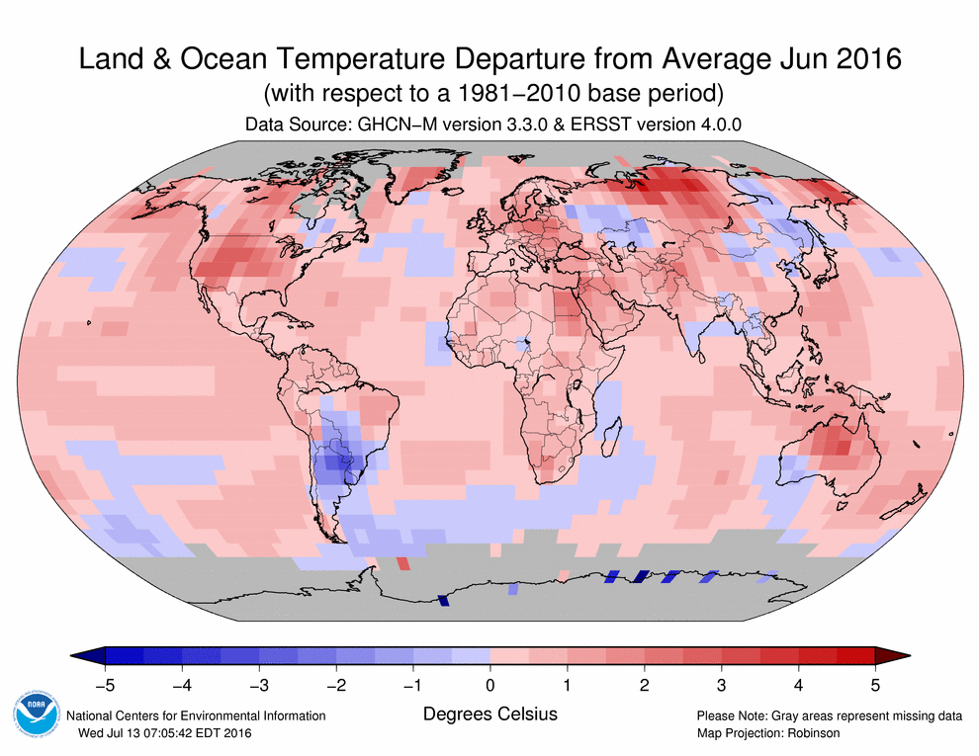
Source of this and many other maps: NOAA - https://www.ncdc.noaa.gov/sotc/global/201606

Slide 9
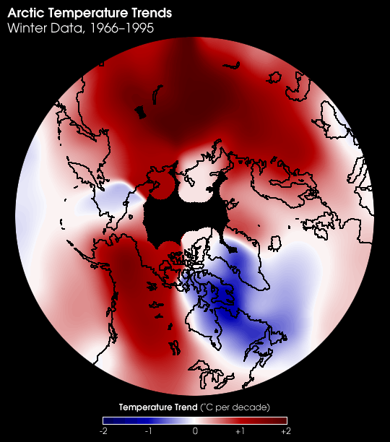
Source: http://visibleearth.nasa.gov/cgi-bin/viewrecord?2966
Can have local cooling at same time have global warming. Need to have a global picture of what is going on.
Animation of the evolution of global pattern (this is a departures of 5 year averages from the average of the complete record – NASA https://svs.gsfc.nasa.gov/cgi-bin/details.cgi?aid=4419

Slide 10
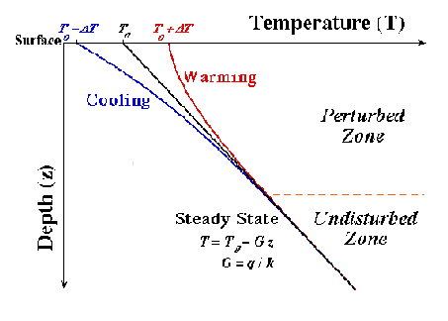
What does the shallow geothermal data indicate?
Shallow borehole Temperatures can reflect local warming versus cooling. Image source: http://www.ncdc.noaa.gov/paleo/borehole/approach.html
PDF of article by Henry Pollack on using this type of data to detect climate change:
ftp://ftp.bartol.udel.edu/anita/amir/Corsika_files/Attenuation_reflectivity/annurev.earth.28.1.pdf (Henry Pollack is a Central High alum).

Slide 11
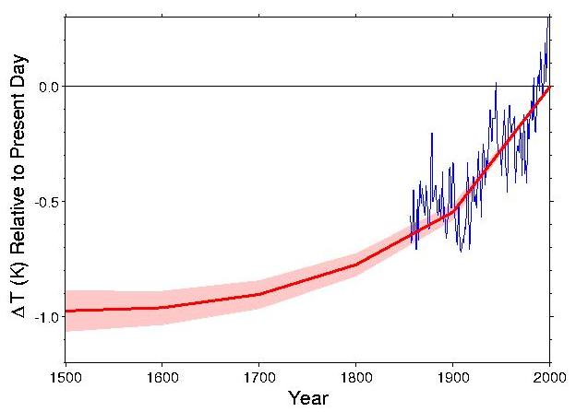
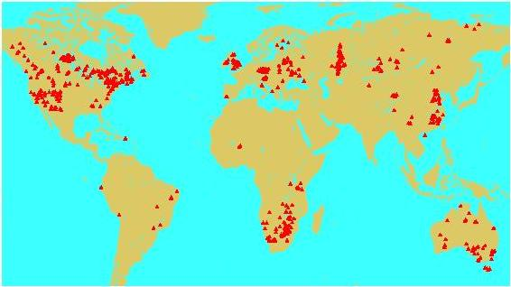
The red line is the average warming as suggested by the borehole data, and the blue is the observed global temperature. The map shows the distribution of borehole data used. Image source: http://www.ncdc.noaa.gov/paleo/borehole/core.html

Slide 12
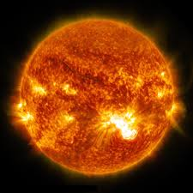

Global climate change & earth system science.
There must be fifty ways to change your climate.
energy
received
energy radiated
A starting place:
Energy received = energy radiated -> climate stability.
Energy received > energy radiated -> global warming.
Energy received < energy radiated -> global cooling.
Energy received decreases -> global cooling.
Energy received increases -> global warming.
Can be more complicated in short term with heat storage in oceans, etc..

Slide 13
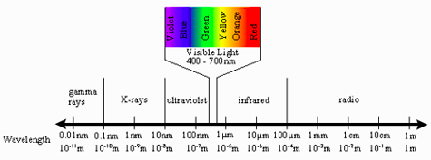
Electromagnetic spectrum and Blackbody radiation.
Image source: http://coralreefwatch.noaa.gov/satellite/education/tutorial/media/em_spectrum.png
The sun glows in the visible spectrum, and the earth glows in the infrared. The visible light the earth absorbs gets emitted as infrared.

Slide 14
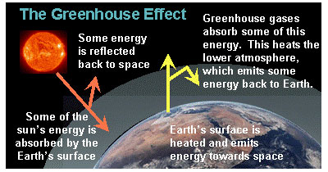
Image source: NOAA site - https://www.ncdc.noaa.gov/paleo/globalwarming/what.html
Greenhouse gases: water vapor, carbon dioxide, methane, ozone, nitrous oxide, CFCs, CO.
Both amount and residence time important.
NOAA site with more details:https://www.ncdc.noaa.gov/monitoring-references/faq/greenhouse-gases.

Slide 15
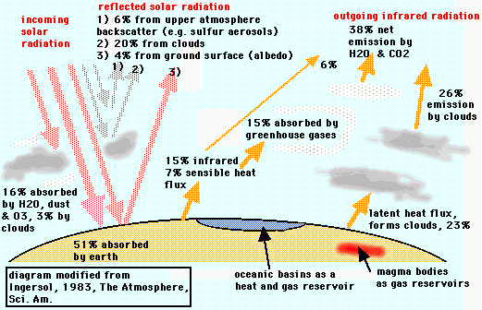

Slide 16
How can the energy balance be changed and global climate change produced?
1) Change how much is reflected back into space:
- by injection of volcanic sulfur aerosols and ash high into atmosphere
- nuclear winter, large asteroid impacts.
- change surface albedo (water, bare land, vegetation & ice reflect differently):
  a change in ice/snow cover can produce positive feedback.
  change in sea level (interesting feedback loops possible here also).
  deforestation changes albedo.
2) Change in greenhouse gas composition in atmosphere:
- burning of fossil fuels.
- exchange with oceanic reservoirs.
- biologic contributions (Gaia hypothesis).
- volcanic contributions out of the ordinary.
This list is far from exhaustive.

Slide 17
Forcing agents + feedback loops:
Forcing agent:
slowly pushes system in one direction.
Milankovich cycles for the earth’s climate is one example.
very long time (billions of years) sun’s luminosity changes.
Feedback loop:
positive versus negative loops.
local atmospheric temperature & melting changing area of sea-ice versus open water mediated by albedo.
warming and methane in permafrost and in deep sea muds.

Slide 18
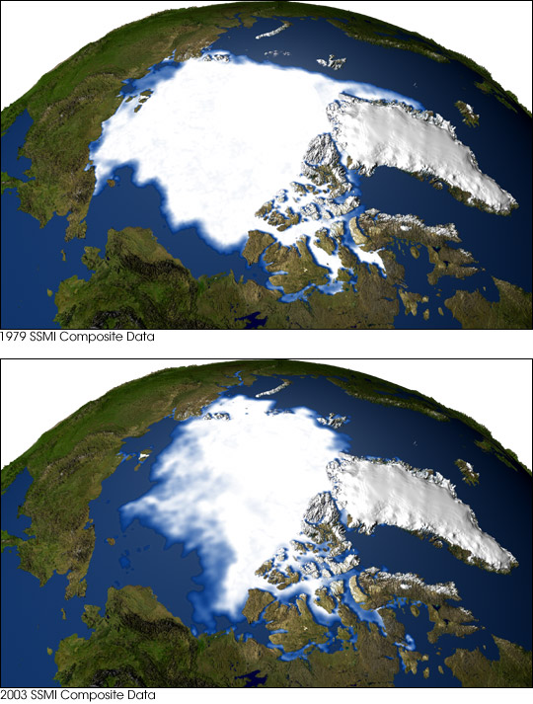
Why is global warming more pronounced in the Arctic?
These images exemplify how Arctic sea-ice extent has decreased with time.
Image source: http://earthobservatory.nasa.gov/Newsroom/NewImages/images.php3?img_id=16340
A positive feedback loop between the sea-ice to open water ratio and melting accentuates the global signal.

Slide 19
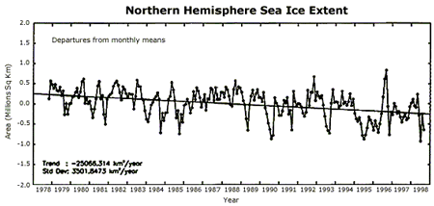
http://yosemite.epa.gov/oar/globalwarming.nsf/content/ImpactsPolarRegions.html#sea
Satellite-derived departures from monthly means in sea ice extent for the Northern Hemisphere, 1978-1998.
Source: National Snow and Ice Data Center
Note the spiky seasonal fluctuations, but the longer trend of overall decrease in ice extent. More recent l data confirm the downward trend. The Arctic ocean could be ice free in the summer in a bit more than a century.
Video of ice through time: https://www.youtube.com/watch?annotation_id=annotation_2737688219&feature=iv&src_vid=H-BbPBg3vj8&v=FDRnH48LvhQ

Slide 20
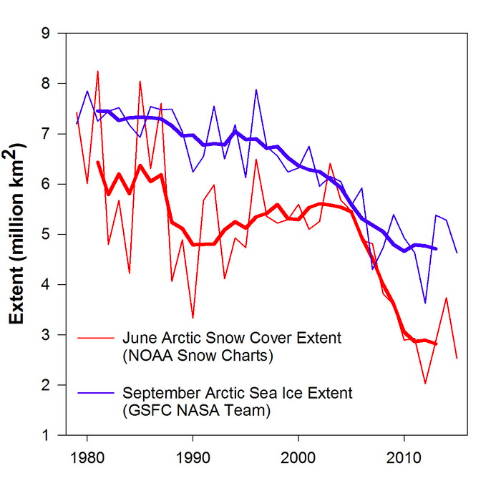
More recent data on both sea ice and snow extent with time in the northern hemisphere. Image source: http://www.arctic.noaa.gov/reportcard/snow_cover.html

Slide 21
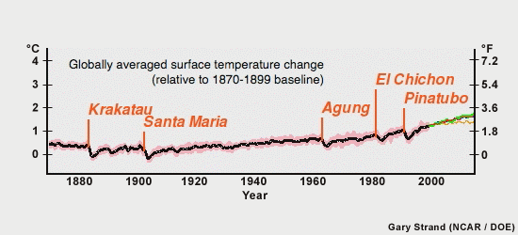
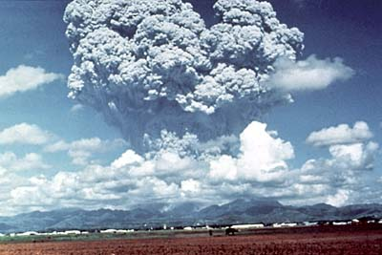
Volcanic eruptions and global climate – the short term effect.
The 1991 eruption of Mt. Pinatubo produced about .5 degree global cooling. Both the volcanic ash and gases (sulfuric aerosols) serve to block sunlight. Image source and more information at USGS site –
http://pubs.usgs.gov/fs/1997/fs113-97/

Slide 22
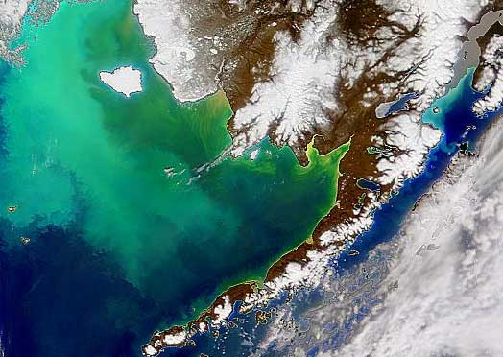
The role of life in climate? Gaia hypothesis
Life on earth (the biosphere) acts in aggregate in such a manner in the long term so as to preserve physical conditions on the earth so that they are favorable for life.
-To start understanding ask the question - what is the atmosphere made of and why??
- Then ask which critical greenhouse gases are strongly biologically mediated.
In the biosphere microbes rule! This is an image of a plankton bloom (population explosion). Photosynthetic plankton draw down CO₂ in the atmosphere. Image source: NOAA - Spring and Fall Phytoplankton Blooms in the Eastern Bering Sea During 1995–2011 - http://www.afsc.noaa.gov/Quarterly/AMJ2014/amj14featurelead.htm
NASA visualization of plankton activity through time - https://svs.gsfc.nasa.gov/3599

Slide 23
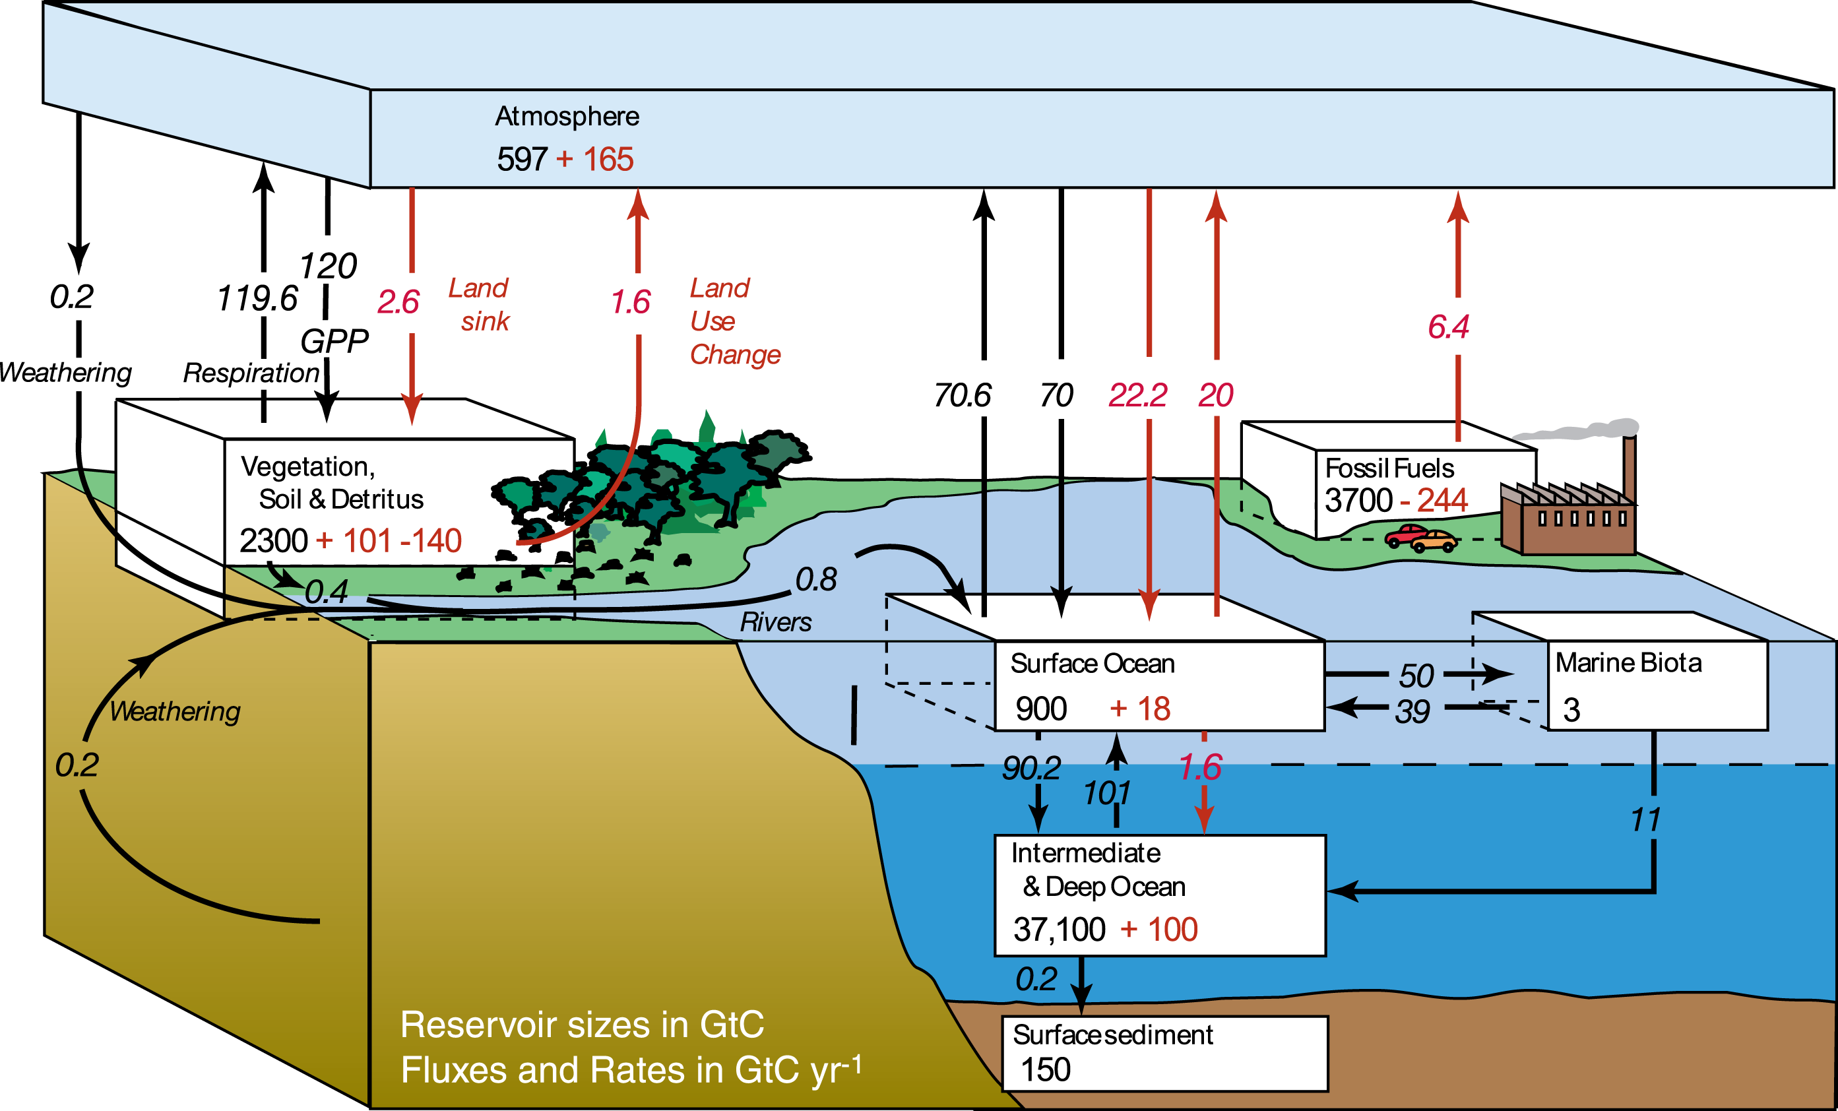
We have explored many mechanisms by which global energy balance and climate can change. What are the rates of change associated w different mechanisms?
Long term – millenia and greater: orbital forcing (Milankovich cycles), changes in continental position, solar evolution.
Potentially short term – decades to centuries: changes in albedo, changes in ocean-atmosphere heat exchange, changes in atmospheric green-house gas content, changes in global phytoplankton activity.
Carbon cycle with reservoir size and fluxes (per year, red numbers). The larger the flux relative to the size of a reservoir, the shorter the residence time, and the greater potential effect a change in the flux can have. Image source: https://www.gfdl.noaa.gov/anthropogenic-carbon-cycle/

Slide 24
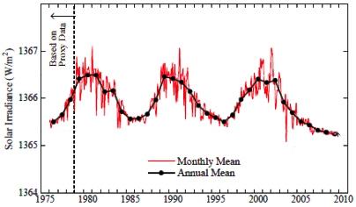
What is driving recent global warming?
increase in atmospheric CO2 content?
  volcanic input.
  Anthropogenic:
    fossil fuel burning
    deforestation
    cement production
increase in water vapor?
solar forcing?
Orbital forcing – not on the right time scale.
Regarding solar forcing, recent satellite data (graph below) shows the sun-spot cycles, but no net increase. Note that the degree of fluctuation is less than .1%. More information and image source at: http://history.aip.org/climate/solar.htm

Slide 25
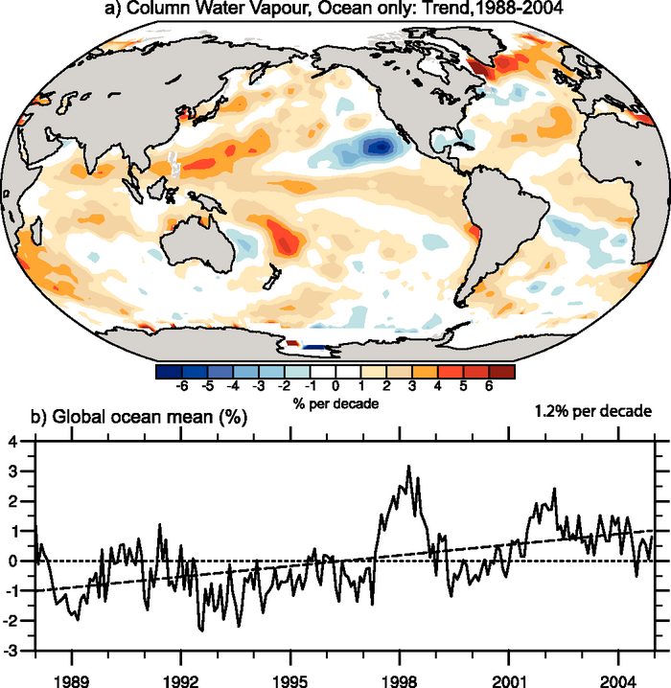
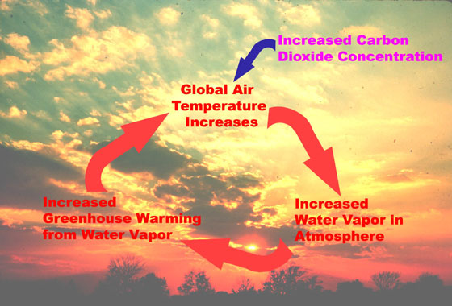
Water vapor as a possibility?
Some evidence water vapor has increased as temperatures have increased.
Atmospheric water vapor increases with temperature, and thus is linked to other green house gases such as CO₂, i.e. water vapor increase can be explained by a CO₂ increase (see below).
Water vapor has a short term residence time in the atmosphere.
Water vapor linked to clouds, which can increase reflection, and have a cooling effect.
Above, example of data. Water vapor is also increasing. More information and graph source: http://www.ipcc.ch/publications_and_data/ar4/wg1/en/ch3s3-4-2-1.html Left image source: https://www.nasa.gov/centers/goddard/news/topstory/2004/0315humidity.html

Slide 26
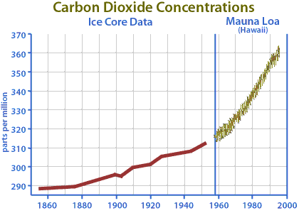
A graph of atmospheric carbon dioxide levels in recent times. http://www.esr.org/outreach/climate_change/mans_impact/man1.html

Slide 27
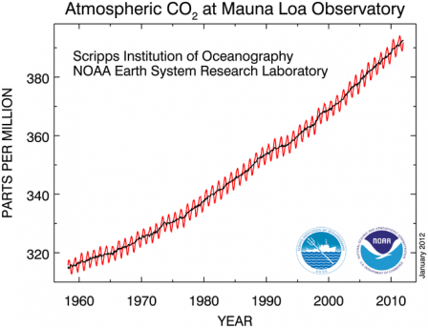
Image from: https://scripps.ucsd.edu/programs/keelingcurve/

Slide 28
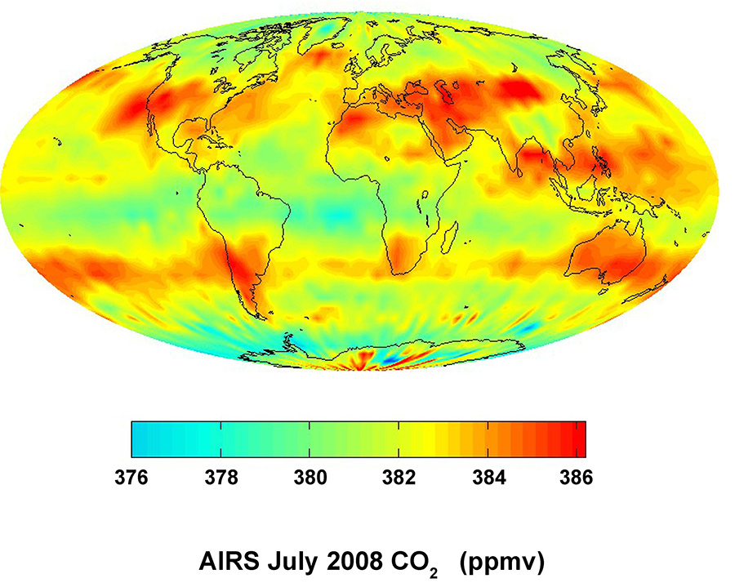
Satellite image of snapshot of carbon dioxide levels in the atmosphere. First note that the range of variation is not that great. Why? Because the turbulent mixing is fairly efficient in the atmosphere. There is a latitudinal component to the pattern. The pattern which changes significantly through time can indicate something about specific sources and sinks for CO2. Image from https://www.nasa.gov/topics/earth/features/airs-20081009.html

Slide 29
What is the source of the CO₂ rise in the atmosphere?
Carbon isotopes provide a basic constraint on where the additional CO₂ is coming from.
Carbon-12: the most common isotopic form of carbon.
Carbon-13: a much less common isotopic form of carbon, but stable.
Carbon-14: a cosmogenically produced radioactive isotopic form of carbon.
How much C-14 in fossil fuels? Basically none. Short half-life and long residence time for carbon in fossil fuels means it has all decayed away.
Plant life is depleted in C-13, because photosynthesis ‘discriminates’ against incorporation of C-13 relative to C-12.
So if fossil fuels are the source of carbon dioxide in the atmosphere, then with time the relative amount of C-14 should be going down, as existing carbon dioxide with radiogenic C-14 in it is diluted by fossil carbon dioxide with none.
The proportion of C-13 should also be going down if fossil fuels or some other plant source are causing the increase, because of the above mentioned preference of plants for C-12 over C-13, giving organic carbon a distinctive signature.
Seuss effect:

Slide 30
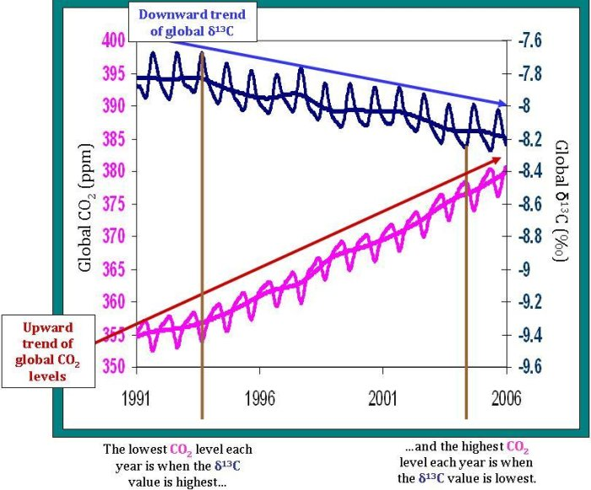
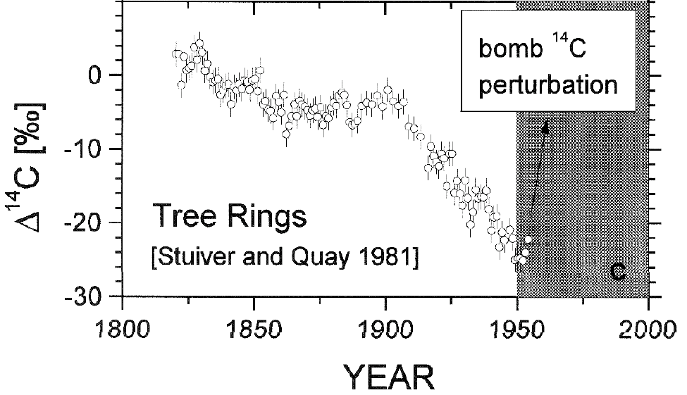
Right: C-13 increase with time: Image source: http://www.esrl.noaa.gov/gmd/outreach/isotopes/c13tellsus.html
Below: C-14 decrease with time until …..
Image source: http://www.skepticalscience.com/print.php?r=384 Taken from Levin et al. - http://archiv.ub.uni-heidelberg.de/volltextserver/6862/
Part of the evidence that burning of fossil fuels is the primary source of the increased CO2 in the atmosphere.

Slide 31
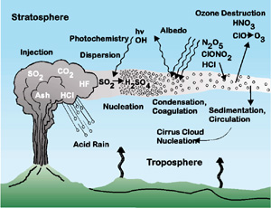
Volcanic emissions a possibility for CO₂ increase?
Volcanic emissions also have almost no C-14 for the same reason that fossil fuels do not, but are not depleted enough in C-13 to explain the observed data (seen in the previous slide).
No evidence for an increase in volcanic activity/emissions in past 100 years. Look at C-cycle – also not of sufficient magnitude.
Large scale eruptions show short term cooling effect not warming effect, mainly because of the SO₂ component.
Diagram from USGS showing various atmospheric effects of volcanic eruptions. Source: http://pubs.usgs.gov/of/1997/of97-262/of97-262.html

Slide 32
What indicates anthropogenic contributions of CO₂ are the significant driver of the temperature increase?
Converging lines of argument (explored more in subsequent slides):
strong temporal correlation between CO₂ increase and temperature recently and in the past.
beyond bounds of history of natural fluctuations (hockey sticks).
consistent with basic physics of greenhouse gases.
Global Climate Model (GCM) results.
lack of other workable causes (such as solar luminosity).
Intergovernmental Panel on Climate Change recent report:
- 1200 scientists contributed to report.
- >90% chance that human activity primary cause for last 50 yrs.
- likely that rate of rise will accelerate in next few decades.
- http://ipcc.ch/report/ar5/syr/

Slide 33
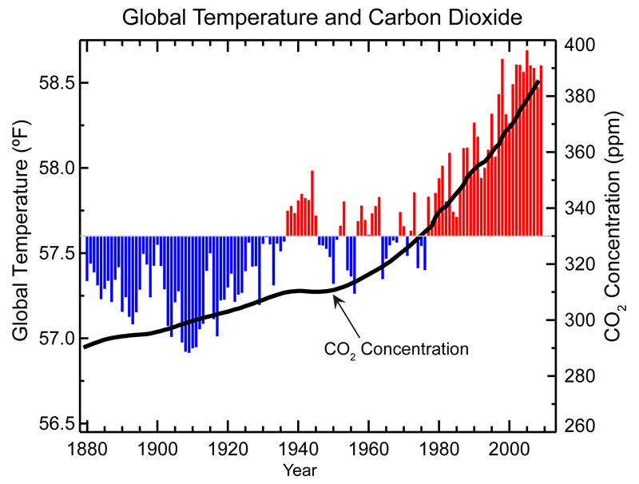
Covariance of global temperature and carbon dioxide. Source - NOAA

Slide 34
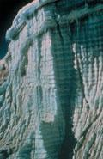

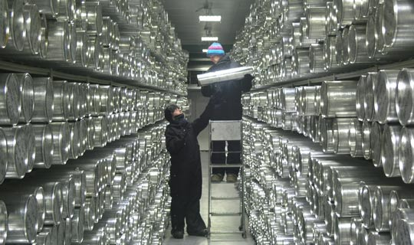
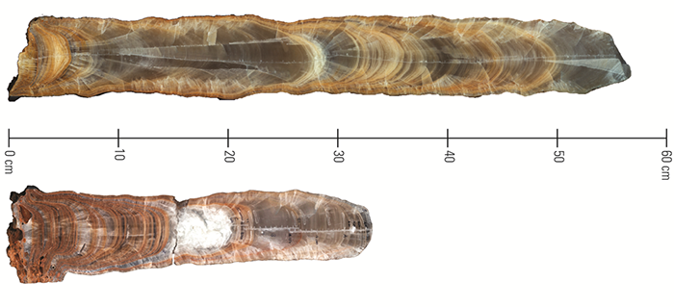
Source of longer term past records of climate fluctuations, and of natural behavior?
Tree rings.
Ice cores.
Lake sediments.
Deep-sea muds.
Speleothem deposits.
Image from: https://www.ncdc.noaa.gov/paleo/globalwarming/proxydata.html
NOAA data center, top image - https://www.ncdc.noaa.gov/data-access/paleoclimatology-data/datasets/ice-core
National Ice Core Laboratory, bottom image - https://www2.usgs.gov/core_science_systems/access/summer_2012/article-7.html
Image source USGS: https://www2.usgs.gov/climate_landuse/clu_rd/paleoclimate/archives.asp

Slide 35
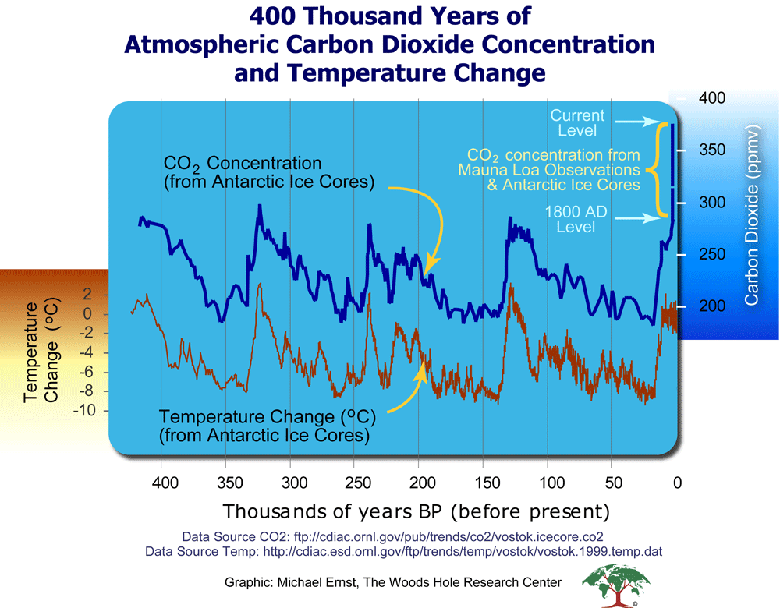
out of range
Note how T and CO₂ rise and fall together – they are strongly linked.
Note how the recent rise of CO₂ is outside of the long-term ‘natural’ history (the puck end of the hockey stick).
Note the sharp T increases relative to slower-longer cooling trends. This is consistent with feedback loops between warming and carbon release.
Long term natural
Variability.
Source: http://www.whrc.org/resources/online_publications/warming_earth/scientific_evidence.htm

Slide 36
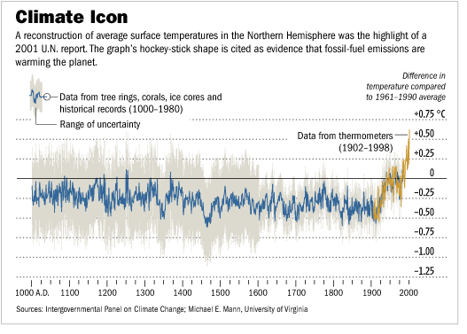
http://equake.geos.vt.edu/acourses/3114/global_warming/

Slide 37
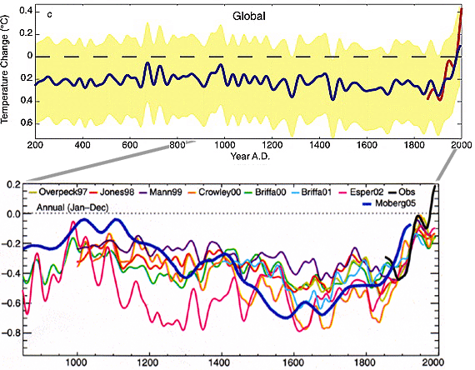
Other hockey stick results from the scientific literature.
Image source: http://www.aip.org/history/climate/xmillenia.htm

Slide 38
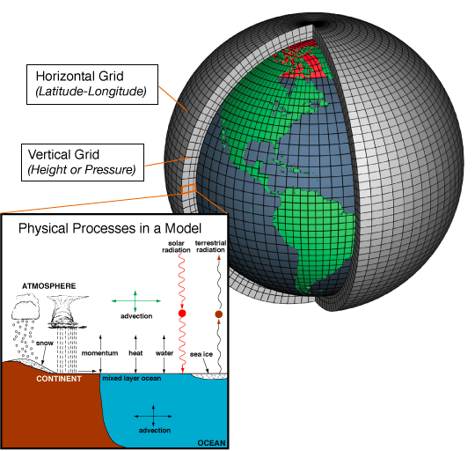
GCMs = Global Circulation Models and Global Climate Models
Examples of finite element models which are used widely in science.
NOAA introduction to GCMs - http://www.gfdl.noaa.gov/cms-filesystem-action/model_development/climate_modeling.pdf
Bloomberg use of GCM to evaluate causes of warming - http://www.bloomberg.com/graphics/2015-whats-warming-the-world/
Image source: NOAA at Wikipedia site - http://en.wikipedia.org/wiki/General_Circulation_Model

Slide 39
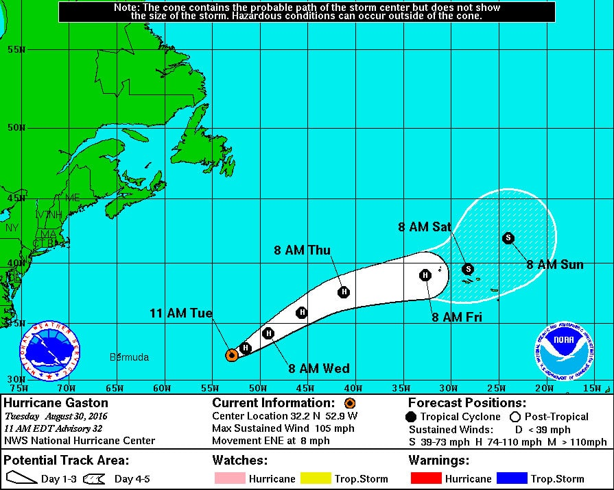
Global circulation models used on a regular basis to predict track of hurricanes, a typical example of which is shown below. Image source: https://www.newsledge.com/nasa-drone-hits-big-first-hurricane-hunting/

Slide 40
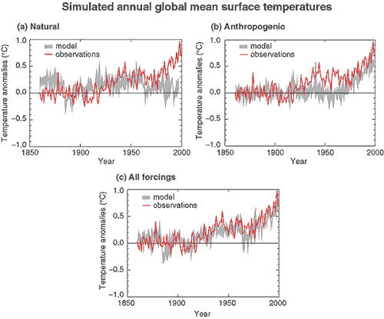
Above shows the ICPC model outputs for three scenarios plotted against the actual history. More recent history shows the temperatures in the atmosphere increasing less than the models, but oceans are warming up more than predicted. http://www.grida.no/publications/other/ipcc_tar/?src=/climate/ipcc_tar/wg1/figspm-4.htm

Slide 41
GCM YouTube presentations of some interest.
YouTube video on GCMs - http://www.youtube.com/watch?v=eZ5yCCc3K14
Direct comparison of a Global Circulation Model and the actual history – 8 minute YouTube: http://www.youtube.com/watch?v=EVDK6Mi_tKg
Comparison of GCMs prediction of Arctic sea ice history and the actual history, then with a future projection - http://www.youtube.com/watch?v=3v9aRQpumPA
Geophysical Fluids Dynamics Laboratory animation - http://www.gfdl.noaa.gov/global-modeling-of-tropical-cyclone-activity
CCSM model animation - http://www.youtube.com/watch?v=qh011eAYjAA
Global Climate Model simulation demonstrating the level of detail - http://www.youtube.com/watch?v=Cxsg7uvVSBE

Slide 42
How will surface system behavior likely change?
Increase in sea level as ice melts and water warms.
Possible change in circulation patterns in the oceans and attendant changes in weather patterns.
Change in size of extreme flood and drought events.
Increase locally in desertification.
Ecosystem shifts, especially in polar regions.
Change in disease vectors and patterns.
Ocean acidification.
Hard (if not impossible) to predict all the changes because of complexity of the system.
Changes will vary greatly from region to region.
Some may be beneficial to humans, some deleterious, but change requires adaptation.

Slide 43
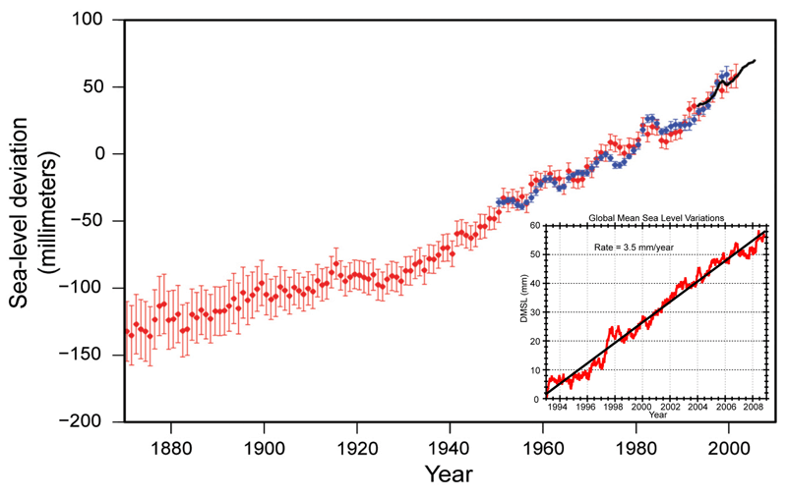
Longer term, but high cost change – sea level increase.
Global sea level rise based on tidal gauging stations, and on satellite data. Is it a linear increase or non-linear? Measuring global sea level is challenging - many factors can influence local sea level. Note how the error bars back in time are larger. Image source: https://www.ncdc.noaa.gov/indicators/

Slide 44
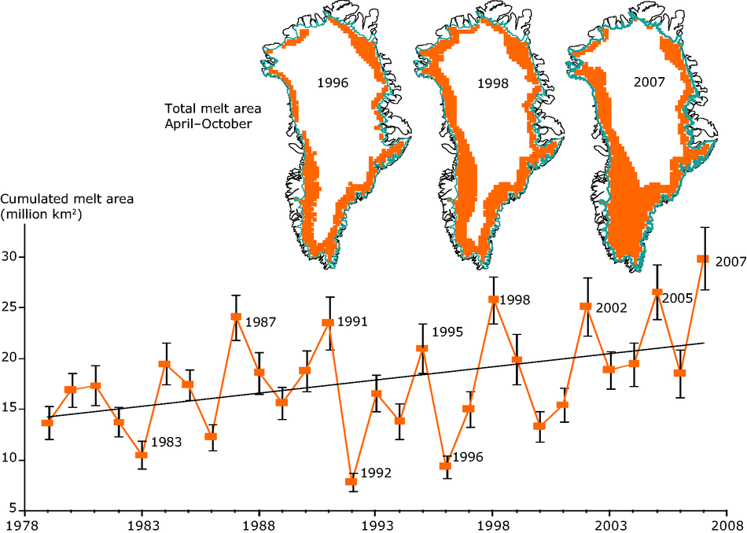
Estimate is a 6 m increase if Greenland Icecap melts.
Image source: http://www.eea.europa.eu/data-and-maps/indicators/greenland-ice-sheet/greenland-ice-sheet-assessment-published Data source: Steffen, K.; Nghiem, S. V.; Huff, R. and Neumann, G., 2004. The melt anomaly of 2002 on the Greenland Ice Sheet from active and passive microwave satellite observations. Geophysical Research Letters 31 (20): L2040210.1029/ 2004GL020444. Witze, A., 2008. Losing Greenland. Nature 452: 798802

Slide 45
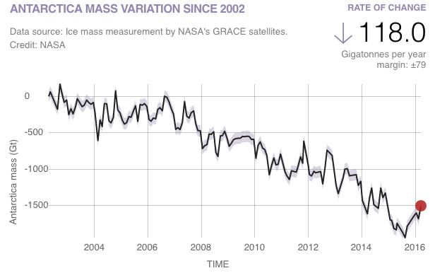
For Antarctic Ice Sheet the story is more complex.
South pole - continent surrounded by water, north pole – the opposite.
Warming can cause an increase in humidity, which can increase snow fall.
GRACE (satellite gravity data) indicates overall mass loss.
Study of elevation data indicates a decreasing rate of mass loss by snow fall (see below.
- 2016 NASA GRACE data - http://climate.nasa.gov/vital-signs/land-ice/
- 2015 NASA Study: Mass Gains of Antarctic Ice Sheet Greater than Losses
https://www.nasa.gov/feature/goddard/nasa-study-mass-gains-of-antarctic-ice-sheet-greater-than-losses

Slide 46
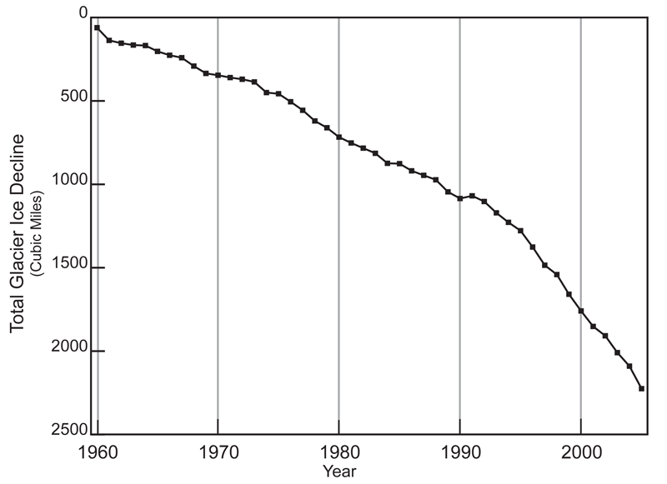
Estimated glacial ice mass lossworld wide. Again, is this a linear history? Image source: https://www.ncdc.noaa.gov/indicators/

Slide 47
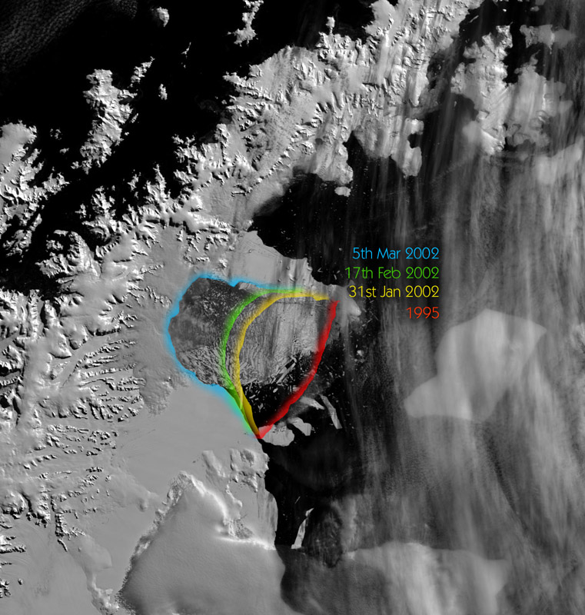
http://www.antarctica.ac.uk/News_and_Information/Press_Releases/2002/composite-larson.jpg
Some focus on ice shelf collapse. Why?
Ice shelf – floating edge of ice sheet, prone to calving.
Collapse signals change in ice sheet dynamics.
Floating ice does not change sea level, but higher ice behind it that moves more swiftly after collapse does.
Satellite images of collapse of Larsen B Antarctic ice shelf

Slide 48
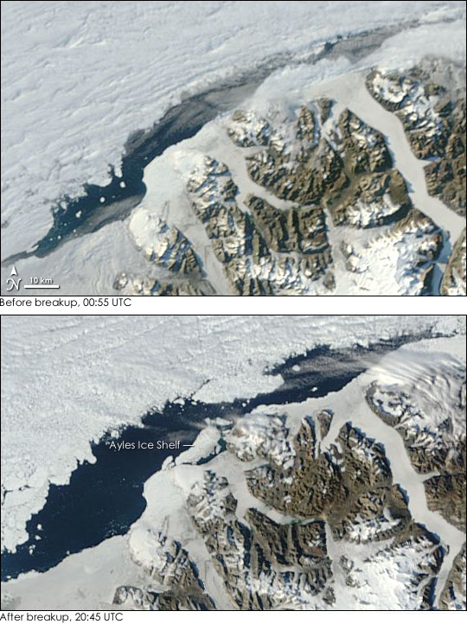
Ice shelf off of Ellesmere island, Canadian Arctic collapses in 2005.
Image source: http://earthobservatory.nasa.gov/Newsroom/NewImages/Images/ayles_tmo_2005225.jpg

Slide 49
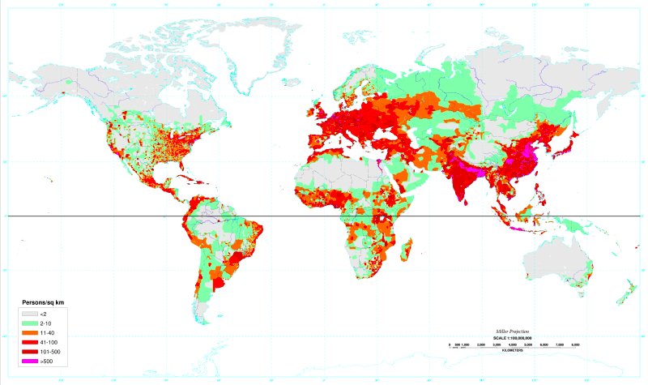
Why a focus on sea-level increase?
1994 population density map – note many coastal areas are higher density. Image source: https://commons.wikimedia.org/wiki/File:World_population_density_1994_-_with_equator.png

Slide 50
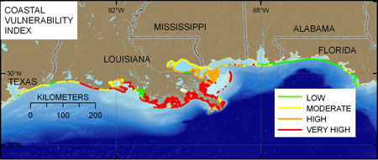
Study by U.S.G.S. - Coastal Vulnerability Assessment of the Northern Gulf of Mexico to Sea-Level Rise and Coastal Change By E.A. Pendleton, J.A. Barras, S.J. Williams, and D.C. Twichell - http://pubs.usgs.gov/of/2010/1146/
Certain coastlines subsidence due to compaction an additional factor increasing the local rate of sea level increase.
Burkett et al. Sea-Level Rise and Subsidence: Implications for Flooding in New Orleans, Louisiana
https://pubs.er.usgs.gov/publication/2000794 -

Slide 51
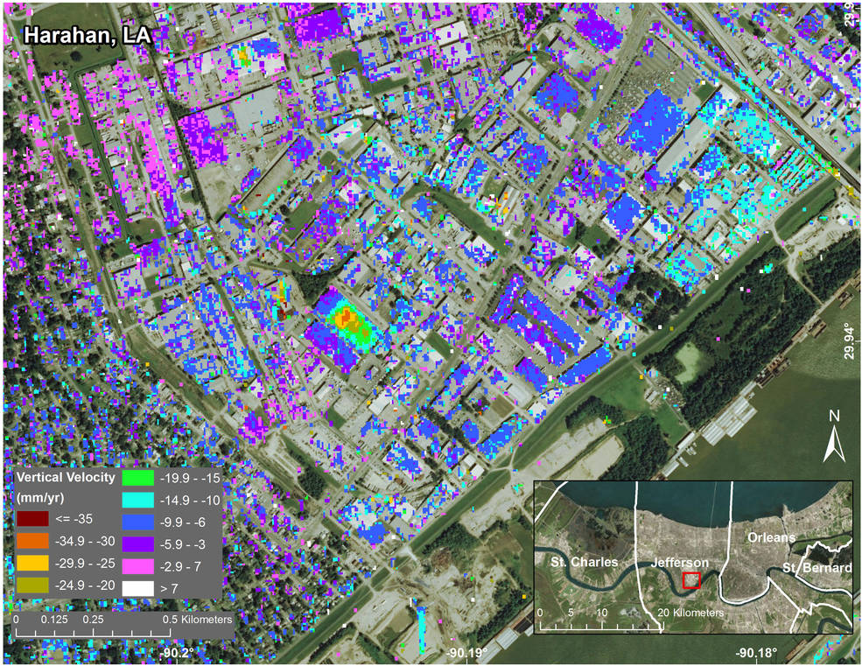
“Subsidence in Jefferson Parish, Louisiana, from June 2009 to July 2012, as seen by NASA’s UAVSAR instrument. The measured displacements are a combination of movement of the ground and of individual structures. The inset at lower right shows the parish location within Greater New Orleans. Credits: NASA/JPL-Caltech, Esri” – Caption quote image source: https://www.nasa.gov/feature/jpl/new-study-maps-rate-of-new-orleans-sinking

Slide 52

Ocean acidification:
Interchange between oceans and atmosphere wrt carbon dioxide.
Carbon dioxide in water makes carbonic acid.
pH a log scale.
change detected (see adjacent graph).
Significance?
Image source: http://www.pmel.noaa.gov/co2/file/Ocean+Acidification+Illustration

Slide 53

What will a change in pH influence?
Abundant aquatic life builds ‘shells’ with a carbonate component (CO₃⁻²) and this would interfere with such activity.
Many other possibilities – pH is a crucial environmental parameter.
Image source: http://www.pmel.noaa.gov/co2/file/Ocean+Acidification+Illustration

Slide 54

Why are ocean waves significant?
Influence erosion and coastal retreat rates.
Most are associated with storms, so a proxy measure of storm intensity/frequency.
Play a role in aerosol and gas exchange between the atmosphere and the oceans.
Seismic data suggest waves have been increasing in power
Seismic noise as a function of wave energy, and mining the records. ABC Science article on this: http://www.abc.net.au/science/articles/2008/04/22/2224118.htm
Somewhat technical article with some details - https://profile.usgs.gov/myscience/upload_folder/ci2012Feb22164000441212010GL043472.pdf . Overall increase in wave energy, shorter term, recent leveling off of increase, ENSO events play an important role.
Image source: http://profile.usgs.gov/pbarnard

Slide 55


More energy can feed more erratic behavior.
GCMs suggest extreme events (floods, droughts, hurricanes, fires, heat waves, and even cold spells in some areas may increase).
Image source (right): 2008, Scientific Assessment Captures Effects of a Changing Climate on Extreme Weather Events in North America
http://www.noaanews.noaa.gov/stories2008/20080619_climatereport.html
A shift in the behavior can be represented mathematically by a change in form, which captures the possibility of extreme events (see graph to left). Image source: Adapted from IPCC (2001) (Ref. 39).

Slide 56

Global Climate Models suggest that with global warming we may expect an increase in extreme events, in size/duration and/or frequency. Insurance companies have done research into this. This image tracks some of the events, and more information can be found at: https://www.ncdc.noaa.gov/sotc/global/201602 .

Slide 57

Due to increase in human infrastructure in vunerable areas or due to climate change, or both (other factors)? Image source: http://www.noaanews.noaa.gov/stories2011/images/billion%20dollar%20graph%20Nov%202011.jpg

Slide 58

Weather a notoriously noisy system. One example from NOAA of the type of data regarding extreme precipitation.

Slide 59

Noise to signal – wave energy as a measure of changing things. There is a world wide seismic network focused on earthquake and nuclear test detection. Microseisms are the continuous hum, once considered noise, but for some stations waves are dominating the noise, and when of interest make the noise a signal..
Image source: USGS site - http://earthquake.usgs.gov/monitoring/helicorders/examples/GeyserPeakWindstorm.php

Slide 60
More and larger hurricanes??
Summary of 2016 NOAA report.
“ - It is premature to conclude that human activities–and particularly
greenhouse gas emissions that cause global warming–have already had a detectable impact on Atlantic hurricane or global tropical cyclone activity. That said, human activities may have already caused changes that are not yet detectable due to the small magnitude of the changes or observational limitations, or are not yet confidently modeled (e.g., aerosol effects on regional climate).
- Anthropogenic warming by the end of the 21st century will likely cause tropical cyclones globally to be more intense on average (by 2 to 11% according to model projections for an IPCC A1B scenario). This change would imply an even larger percentage increase in the destructive potential per storm, assuming no reduction in storm size.
- There are better than even odds that anthropogenic warming over the next century will lead to an increase in the occurrence of very intense tropical cyclone in some basins–an increase that would be substantially larger in percentage terms than the 2-11% increase in the average storm intensity. This increase in intense storm occurrence is projected despite a likely decrease (or little change) in the global numbers of all tropical cyclones.
- Anthropogenic warming by the end of the 21st century will likely cause tropical cyclones to have substantially higher rainfall rates than present-day ones, with a model-projected increase of about 10-15% for rainfall rates averaged within about 100 km of the storm center.”
Global Warming and Hurricanes, NOAA https://www.gfdl.noaa.gov/global-warming-and-hurricanes/

Slide 61

Example of the type of data looked at from: https://www.gfdl.noaa.gov/global-warming-and-hurricanes/

Slide 62

Earth System/Climate Engineering (instead of Earth System Science):
Carbon sequestration (takes many forms).
Space mirrors.
Sulfur aerosol injection.
White roofs (on a smaller scale – urban heat islands).
Cloud seeding.
National Academy of Engineering work on Earth System Engineering: http://www.nae.edu/Publications/Bridge/TheVertiginousMarchofTechnology/EarthSystemsEngineeringTheWorldAsHumanArtifact.aspx

